Slide 1
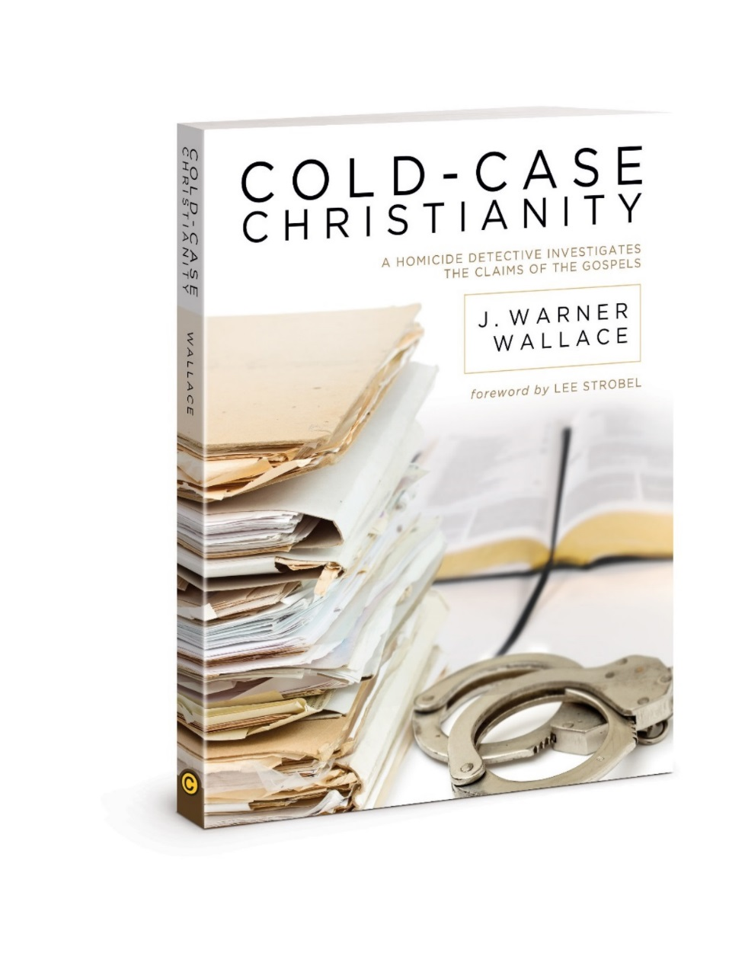
Chapter 6
Separate Artifacts from Evidence
Notes:
-Ever heard someone say there are “errors” or “mistakes” in the bible?
-This chapter shows how to answer criticisms of the bible with a comparison of a crime scene scenario

Slide 2

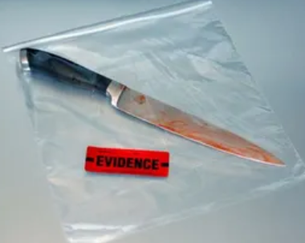
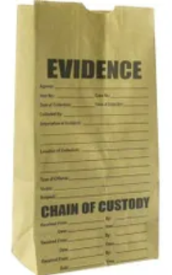
Crime Scene Comparison
Yellow tape
Artifacts – items collected in scenes (in bags)
Everything collected is an artifact
Larger area = more artifacts (can get unrelated artifacts)
Small area = less artifacts (can miss things)
Jury decides which artifacts are evidence
Notes:
-Everything:: can be anything from an eraser, pencil, knife, footprints, blood spatters, etc.
-Larger:: ie.)a cigarette bud could be found 3 blocks away. The chance you are gathering items unrelated to the crime increases.
-Jury:: That cigarette we found 3 blocks away… The defense could argue that DNA not found on a cigarette bud exonerates the defendant when in actuality it may have been unrelated to the crime alltogether

Slide 3
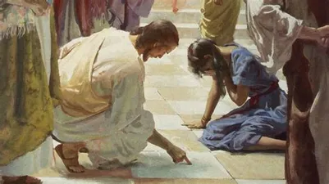
Bible Artifact – Example 1
Woman caught in adultery that Jesus saves
Not present in earliest John manuscripts
Found in 5th century manuscripts
AD 200 manuscripts do not have it

Slide 4
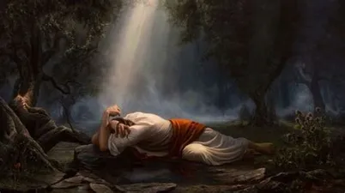
Bible Artifact – Example 2
Luke 22:43-44 "and there appeared an angel unto him from heaven, strengthening him. And being in an agony he prayed more earnestly: and his sweat was as it were great drops of blood falling down to the ground" (KJV).
Do not appear in early Luke manuscripts

Slide 5
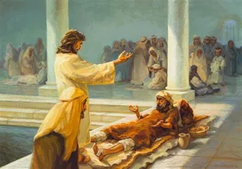
Bible Artifact Example 3
John 5:4 "For an angel went down at a certain season into the pool, and a troubled the water: whosoever then first after the troubling of the water stepped in was made whole of whatsoever disease he had" (KJV").
Earliest manuscripts do not contain

Slide 6
Skeptic Response
If those verses are “false”
What else is “false”?
If those verses are not supposed to be there, What other verses are not supposed to be there?

Slide 7
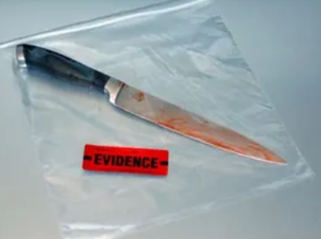
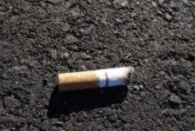
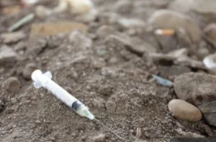
Are Unrelated Artifacts a Problem?
J. Warner Wallace never came across a crime scene that did not have unrelated artifacts
Always there
Must be able to distinguish
Evidence leads to the truth
Unrelated artifacts cause uncertainty
Notes:
-Must:: between unrelated artifacts and evidence
-Evidence:: A bloody knife at a murder scene is likely related and help us get to the truth of what happened
-Unrelated:: ie.)Syringe left behind by paramedics can cause uncertainty about what happened, until you discover they are unrelated ie.)The cigarette bud found 3 blocks away from a crime which had no ties to the suspect is likely an artifact, but can cause confusion

Slide 8
Separate Artifacts from Evidence
We saw “artifact” examples from the Bible
With or without, they do not change the meaning
Most Christians unaware of these unrelated artifacts in their bibles and they bring uncertainty when revealed without an adequate explanation

Slide 9
How to Separate Them?
Identify “late additions”
In court, any 'evidence' not presented in court is said to not be evidence.
Investigators usually discard late additions as evidence

Slide 10
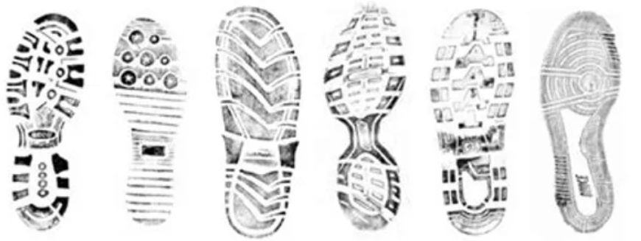
Hard to Tell?
Can’t tell if it’s an unrelated artifact or evidence?
See which scenario makes most sense
Notes:
-see:: An example of a late addition could be: a footprint of land lord who reported the crime If he has a solid alibi, the footprint is an unrelated artifact. Not evidence.

Slide 11
How does this relate to the Bible?
100’s early ancient manuscripts similar to photos taken at crime scene
Late text additions can be discarded as unrelated artifacts, which distract from the truth
They are not evidence that the Bible is untrustworthy
No historical crime scene is without unrelated artifacts

Slide 12
What about the adulterous woman passage?
If we took it out, would it change anything? No.
Is the ‘character’ of the passage consistent with the rest of the evidence for what we know about Jesus? Yes.

Slide 13
Why would copyists change the text?
Typos
Attempted clarification (not always correct)
But Textual Criticism: weeds out most of those issues
Notes:
Textual Criticism: (comparison of multiple manuscripts to determine what the original said)

Slide 14
Pieces of a puzzle
Scenario: drawer with scissors, batteries, and puzzle pieces
Easy to determine that scissors and batteries have nothing to do with puzzle
Even with missing puzzle pieces, we still get a partial, yet better picture than before

Slide 15
Conclusion
The “Bible was corrupted due to late additions” claim does not hold weight with regards to unrelated artifacts in the text
If courtrooms acted like skeptics, no conviction would ever happen
Not rational to discount evidence due to existence of unrelated artifacts
Notes:
-If – because every single case always has unrelated artifacts

Slide 16
for more information visit:
www.ColdCaseChristianity.com

